Slide 1


Contemporary Grammar of English 4th Year
Assist. Lect. Abbas Muhsin Al-Maliki
Department of English

Slide 2
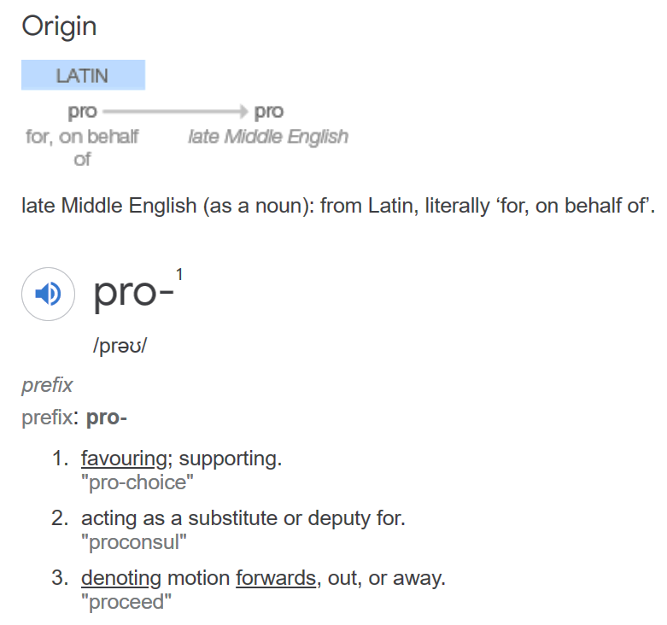
1. Pro-Forms
- Dictionary Meaning of Pro:
Pro; acting as a substitute or deputy for
In linguistics, a pro-form is a type of function word or expression that stands in for (expresses the same contentas) another WORD, PHRASE, CLAUSE OR SENTENCE where the meaning is recoverable from the context.
They are used either to avoid repetitive expressions or in quantification (limiting the variables of a proposition).

Slide 3
Pro-Forms
In linguistics, a pro-form is a type of function word or expression that stands in for (expresses the same content as) another WORD, PHRASE, CLAUSE OR SENTENCE where the meaning is recoverable from the context.
They are used either to avoid repetitive expressions or in quantification (limiting the variables of a proposition).
Assist. Lect. Abbas Muhsin Al-Maliki

Slide 4
Pro-Forms
A ‘pronoun’ can serve as a replacement for a noun:
John searched the big room and the small one
More usually, however, pronouns replace noun phrases rather than nouns:
The man invited the little Swedish girl because he liked her.
Assist. Lect. Abbas Muhsin Al-Maliki

Slide 5
Pro-Forms
3. There are pro-forms also for PLACE, TIME, and Other Adverbials under certain circumstances:
Mary is in London and John is there too.
Mary arrived on Tuesday and John arrived then too
John searched the big room very carefully and the small one less so.
Assist. Lect. Abbas Muhsin Al-Maliki

Slide 6
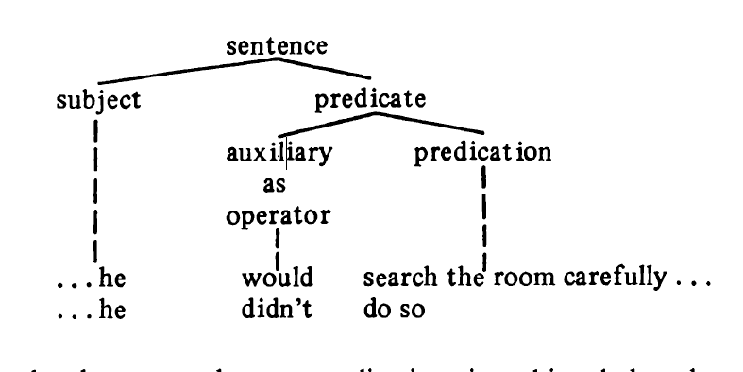
Pro-Forms
But SO has a more important pro-function, namely, to replace — along with the ‘pro-verb’ do — a predication:
She hoped that he would search the room carefully before her arrival but he didn’t do so
Assist. Lect. Abbas Muhsin Al-Maliki

Slide 7
Frequently, however, the pro-predication is achieved by the operator alone:
A: He didn’t give her an apple. B: Yes, he did. They suspected that he had given her an apple and he had
Assist. Lect. Abbas Muhsin Al-Maliki

Slide 8
Question and Negation
‘Wh’-Questions
Wh-Words of English as a special set of pro-forms diametrically opposed to the others in having the general meaning ‘It has not been known what this item refers to and so it needs to be stated in full’. This informal statement will account for the use o f wh-forms in questions:
Mary is in London
Mary is there
Where is Mary?

Slide 9
Wh-Questions
They (subject-i) make him (ii. object) the chairman (iii. complement) every year (iv. adverbial)
Who makes him the chairman every year? [i]
Whom do they make the chairman every year? [ii]
What do they make him every year? [iii]
When do they make him the chairman? [iv]
Assist. Lect. Abbas Muhsin Al-Maliki

Slide 10
‘Yes-No’ Questions: questions which seek a Yes or No response in relation to the validity of (normally) an entire predication:
Operator+ the subject+ the predication
Is the girl now a student?
Did John search the room?
Had he given the girl an apple?
Assist. Lect. Abbas Muhsin Al-Maliki

Slide 11
Negation and non-assertion
Negative sentences involve the operator, requiring the insertion o f not (or the affixal contraction -n’t)between the operator and the predication:
The girl isn’t a student.
John did not search the room.
He hadn’t given the girl an apple.
Assist. Lect. Abbas Muhsin Al-Maliki

Slide 12
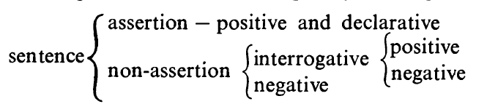
Negation and non-assertion
He offered her some chocolates (Assertion)
A sentence can be Non-Assertive in one of two ways: by being negative or by being a question.
Positive (Assertive): Negative (Non-Assertive)
Declarative (Assertive): Interrogative (Non- Assertive)

Slide 13
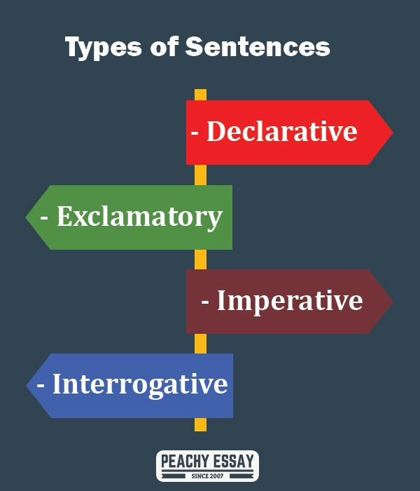
He Stopped.
How he stopped!
Stop!
Did he stop
Assist. Lect. Abbas Muhsin Al-Maliki

Slide 14
Examples:
He offered her some chocolates. (Positive-Declarative)
Did he offer her any chocolates? (Interrogative)
He didn’t offer her any chocolates. (Negative)
Assist. Lect. Abbas Muhsin Al-Maliki

Slide 15
Parts of Speech
The structures realizing sentence elements are composed of units which can be referred to as parts of speech.
A- Open-System Items (Lexical)
Noun — John, room, answer, play
Adjective — happy, steady, new, large, round
Adverb — steadily, completely, really, very, then
Verb — search, grow, play, be, have, do

Slide 16
Parts of Speech
A- Open-Class Items (Lexical)
Noun — John, room, answer, play
Adjective — happy, steady, new, large, round
Adverb — steadily, completely, really, very,
Verb — search, grow, play, be, have, do
B- Closed-System Items ( Functional)
article — the, a(n)
demonstrative — that, this
pronoun — he, they, anybody, one, which
preposition — of, at, in, without, in spite of
conjunction — and, that, when, although
interjection — oh, ah, ugh, phew

Slide 17
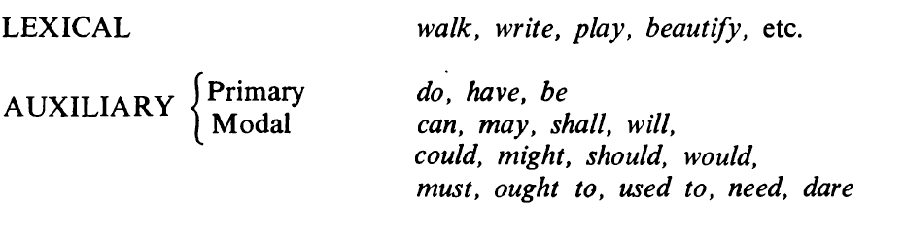
Types of Verb
Assist. Lect. Abbas Muhsin Al-Maliki

Slide 18
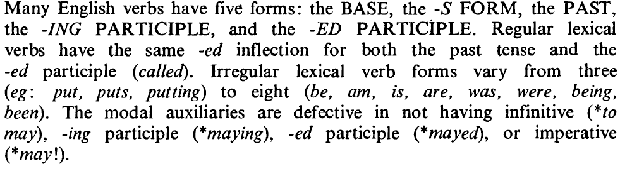
VERBAL FORMS AND THE VERB PHRASE
Many English Verbs have 5 forms:
 | the base 1- | -S Form 2- | the Past 3- | the –ING 4- | Ed Participle 5-
regular lexical verbs | call play move | calls plays moves | called played moved | calling playing moving | called played moved ( 5 Forms
irregular lexical verbs | put | puts | put | putting | put (3 Forms)
 | go | goes | went | going | gone ( 5 forms)
 | be | is, are, am | was, were | being | been (8 forms)

Slide 19
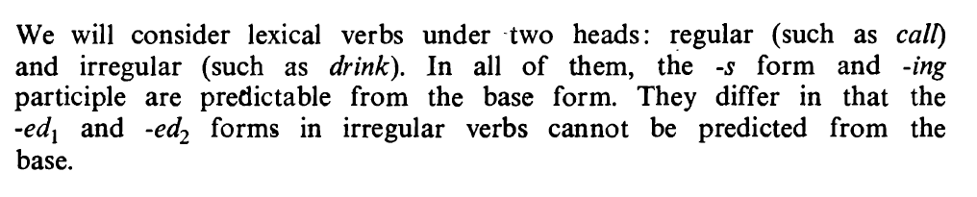
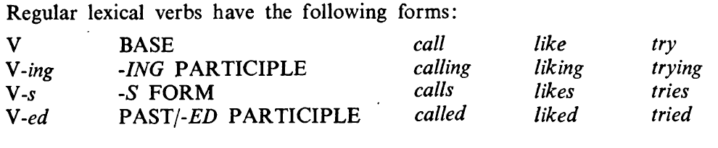
The morphology of lexical verbs
Assist. Lect. Abbas Muhsin Al-Maliki

Slide 20
The ‘-ing’ and ‘-s’ forms
The -ing form is a straightforward addition to the base:
push; pushing sleep ; sleeping
The -s form is also predictable from the base. It has three spoken realizations: /iz/, /z/, and /s/, and two spellings, -s and -es.
Pronounced /iz/ after bases ending in voiced or voiceless sibilants and spelled -es unless the base already ends in -e, eg
pass ^ passes budge ^ budges '
buzz buzzes push pushes
catch catches camouflage ^ camouflages
Assist. Lect. Abbas Muhsin Al-Maliki

Slide 21
‘-s’ forms
(2) Pronounced /z/ and spelled -s after bases ending in other voiced sounds, eg
call ^ calls rob ^ robs flow flows
Note: do ^ does go ^ goes
say says have has
(3) Pronounced /s/ and spelled -s after bases ending in other voiceless sounds, eg
cut cuts lock ^ locks sap ^ saps
Assist. Lect. Abbas Muhsin Al-Maliki

